Slide 1
Sustainable Water Testing Systems Solutions
Developed and Designed By
Kiran Kumar

Slide 2
Many areas around the world survive on natural water supplies like wells, ponds, dugouts, and lakes. In such cases, testing the quality of water becomes vital as it directly affects the health of all individuals involved. The water quality may deteriorate over time or suddenly, and most of the times, the change goes undetected. Continuous water quality testing determines speciﬁc issues and ensures the safety of the water.
PROBLEM STATEMENT
2

Slide 3
If we talk about water purity and pollutants testing, the process is time taking and the ground level data goes through a number of processes and is thus affected. Moreover, the task is tedious and cannot be done on a daily basis, leaving loopholes in purity testing and maintenance of water quality. The present scenario asks for a solution which can cater this need and enable regular quality testing of water and analysis of parameters of water bodies effectively and detecting the zones which are contributing recklessly to the pollution of water.
PROBLEM
3

Slide 4
In India, the population of Delhi and other neighbouring states face a lot of health and pure water drinking issues due the harmful contents present in the Yamuna River due to the dumping of industrial and chemical waste into it, It consists of various metallic and non-metallic elements which is also destroying the
aquaculture. A report says around 500 ﬁshes approximately die due to choking because of the pollutants, which is awful. This was just a brief description of the status of the River which is considered as goddess as per Hindu religion, but such scenarios are widely prevalent all over the world, where we see that our water bodies are being exploited recklessly.
PROBLEM
4

Slide 5
Project Objective
Water quality maintenance is crucial in strategizing control cum preventive measures to reduce water pollution and degradation of aquatic ecosystems. Periodic monitoring of water quality is an essential exercise that can help to keep track of hydrological information status of any water body. Many existing systems and methodologies seem to be ineffective in achieving the objective of the same, and few other typical methods have shown a phenomenal outcome that helped to restore and maintain water bodies from accumulation of nutrients and organic compounds that triggers quality degradation. Yet the statistics all around the globe infers the improvement of water quality and water quality monitoring system. This project presents the major limitations of existing water quality monitoring techniques followed by most of the nations and added to that a proposal on a new system that can make water quality monitoring more efficient in their prime objective of preventing on-going pollution control trends. Advancements in the fields like embedded system, Unmanned surface vessels, and IOT are the technologies that can be used to monitor the quality of water.Water pollution is killing millions of Indians. More than 163 million people 19.3% of the Indian population in India do not have access to clean water. This is the worst situation in the world. As India grows and urbanizes, its water bodies are getting toxic. It is estimated that around 70% of surface water in India is unfit for consumption. Lack of water, sanitation and hygiene results in the loss of 400,000 lives per year in India.

Slide 6


Sample Case Study (Yamuna River)
5
DELHI

Slide 7
CASE STUDY - YAMUNA
“We investigated the impact of urban runoff on the water quality of the Yamuna River in Delhi, which ﬂows into the Agra canal and is used for irrigation purposes. "Results showed drastic variations in each of the water samples after treatment,” “Water pollution levels are higher by multiples than the limit prescribed by the pollution control authorities for irrigation. The water quality of Yamuna is polluted and not suitable for any other purposes,” he said.
- R S Dubey, Department of Applied Chemistry, Amity University, Noida, the author of the study.
TESTIMONY
6

Slide 8
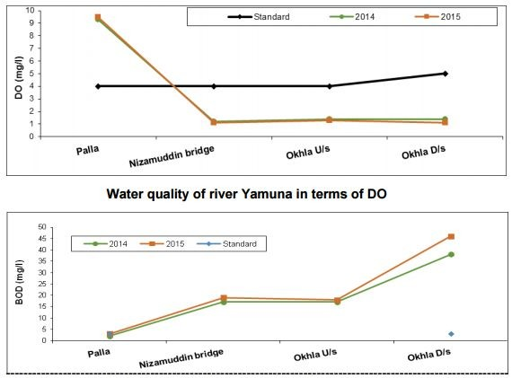
Parameters Indication
TESTIMONY
7

Slide 9
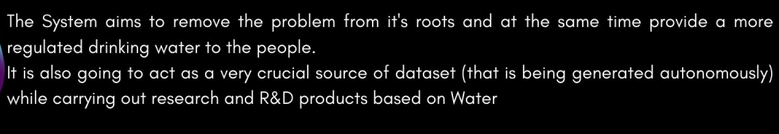
Qualitative Accomplishment of the Project

Slide 10



EXISTING SOLUTIONS ARE :
TIME TAKING
NO REGULARITY
EXPENSIVE SOLUTIONS
The testing and publishing of
There is a variation in the time
The existing Expensive and efficient
Solutions are not energy
water purity
reports and taking
intervals samples holes.
of testing of water and it leaves loop
samples is time tedious task
and a
PROBLEM
9

Slide 11


THE SMART WATER SOLUTION FOR TACKLING WATER POLLUTION
It is a smart low cost sensor based device which has the capability to ﬂoat on the surface (controlled) of the water body and sense various parameters of the water which are fundamental for the purity and status testing, pH level, Dissolved Oxygen, Turbidity, Temperature etc. are namely a few. Once the device records these data in the embedded MCU, it will publish that data on the web server in real time. This will empower the authority to monitor and analyse the parameters/sensor reading of the water body in real time through a front-end website. It will enable the authority to track and detect various soruces of pollutants and components in the water body.
10

Slide 12

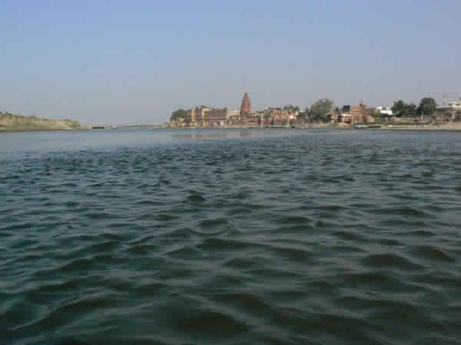


Virtual Representation
The Sustainable Water Testing System System will be made to float in a selected water body, and the movement can be controlled remotely.
11

Slide 13






Sustainable Water Testing System
Virtual Representation
The MCU which will store and stream the data
on the web server through PHP POST method.
Above the Surface
Under the surface
Motorised Fans for movement
The main body consisting of the Testing unit and sensor calibration module
Air holes for Dissolved Oxygen Test and easy movement
pH Level, temperature, Dissolved Oxygen Level and other parameters sensors
PRAVEEN KUMAR

Slide 14




Sustainable Water Testing System
Virtual Representation
Above the Surface
Under the surface
Database (MySQL)
Front-end Website Real time Data Monitoring
(Google Cloud Platform Hosting)
13

Slide 15
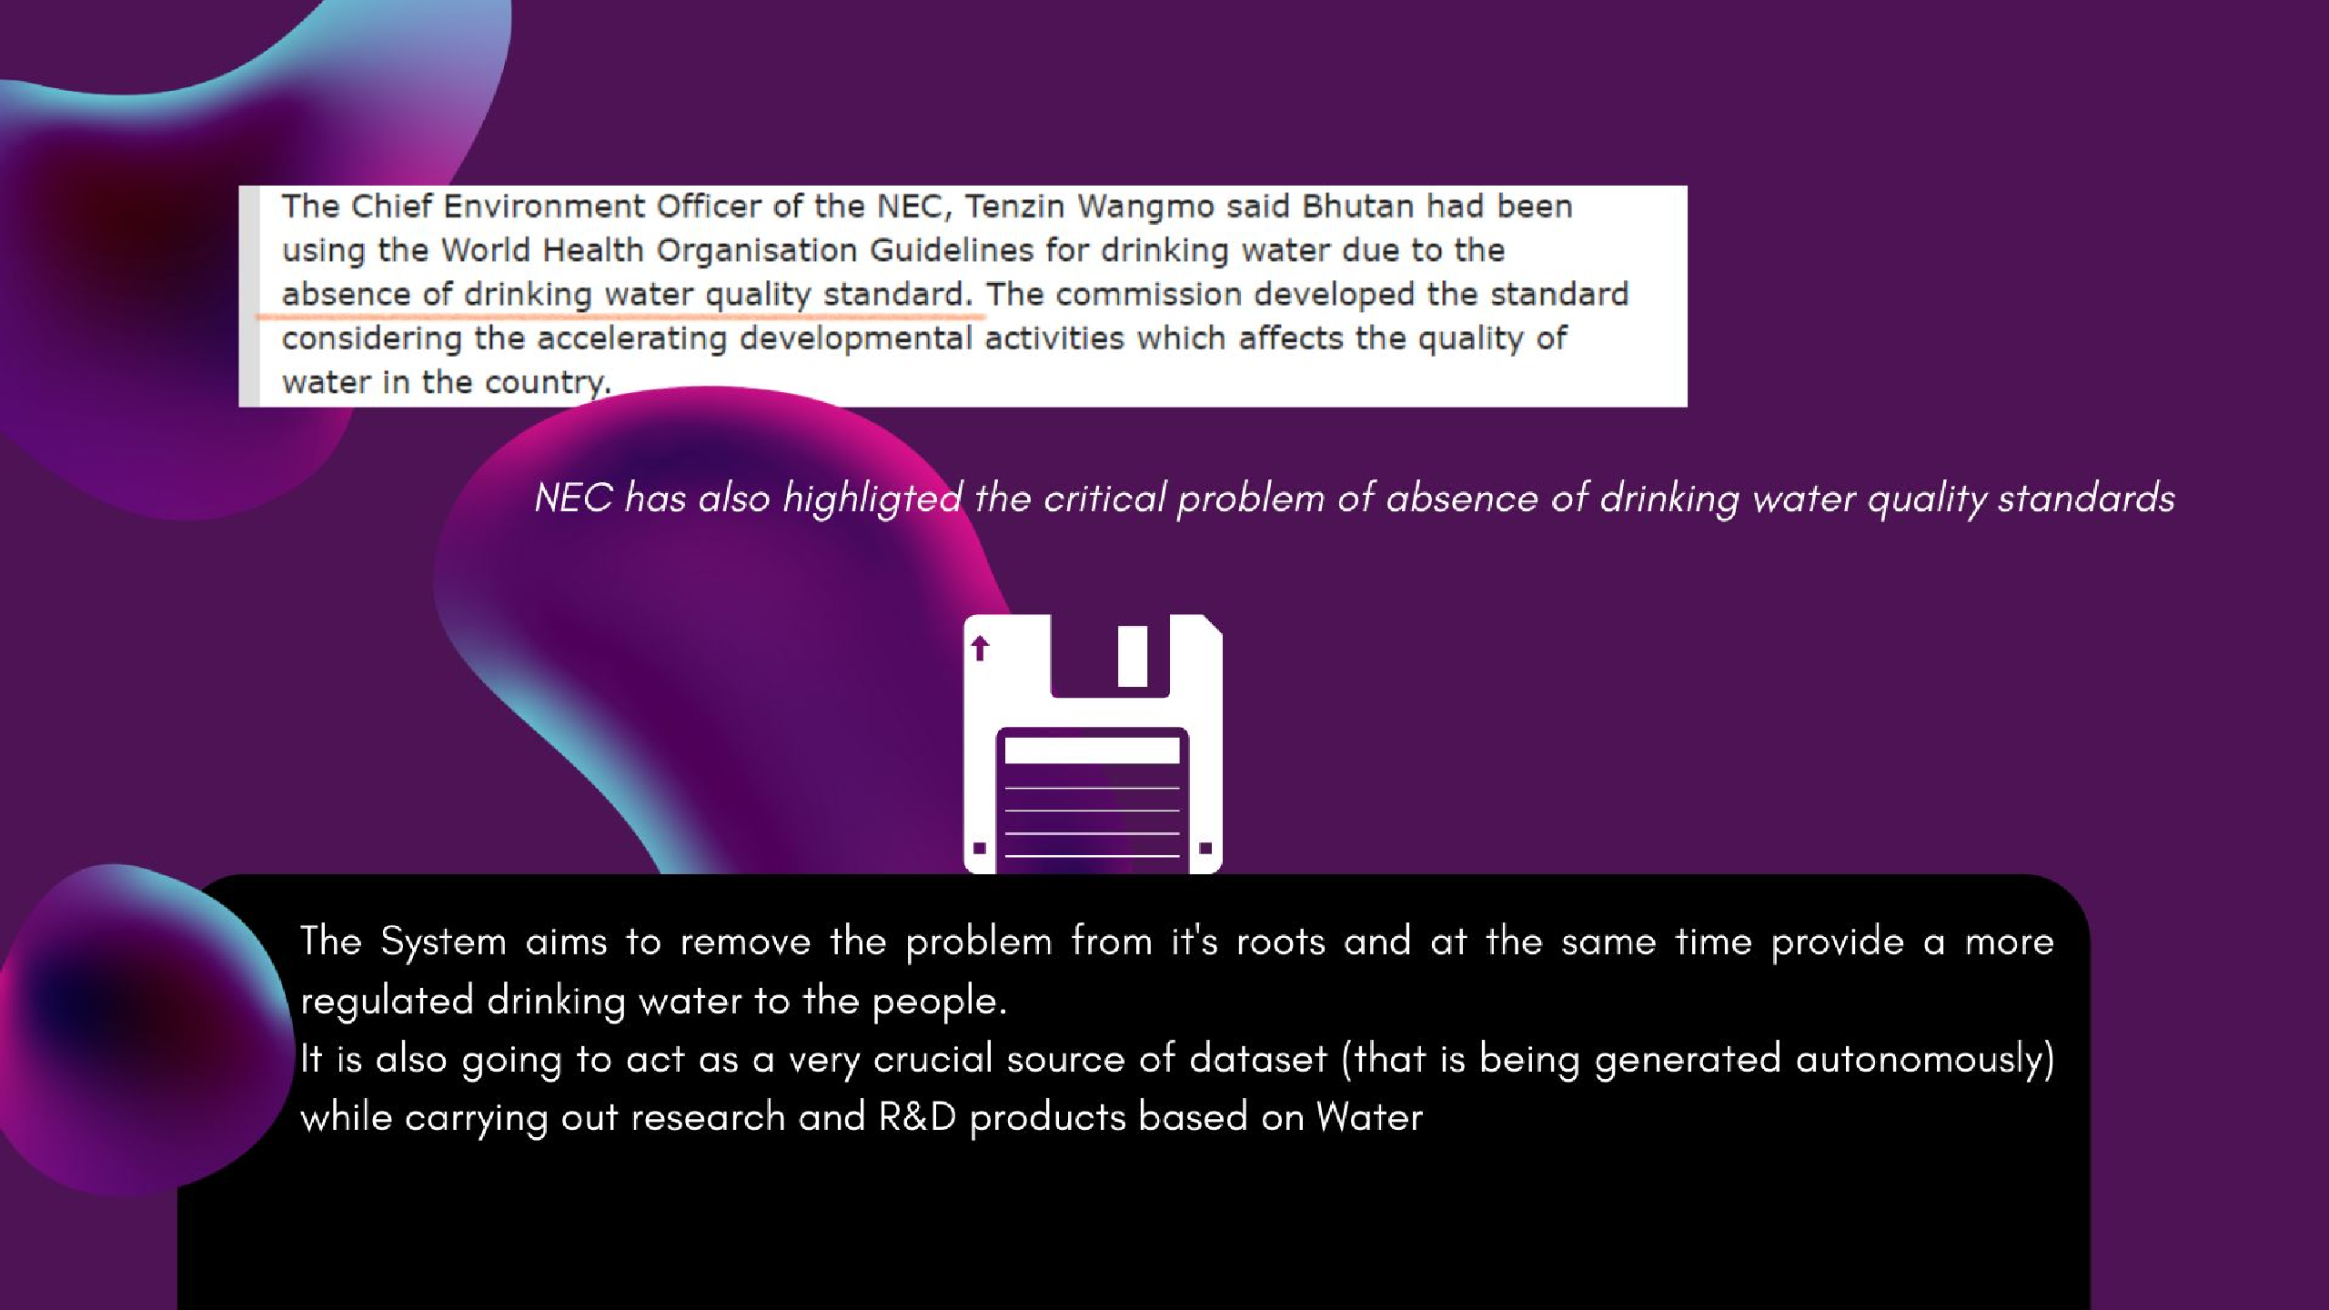

14

Slide 16

Sustainable Water Testing System
The front-end web platform will enable the person to view : 1.) Zone mapping with keys such as (High pH level,Moderate pH level, High Turbidity etc, low dissolved oxygen due to sewage dumping)
2.) Overall Pollution and impurity mapping of the water
body
3.) Purity Percentage calculation according to the the data
taken.
4.) Manual analysis of temperature thorugh Heat maps of
the zones
15

Slide 17
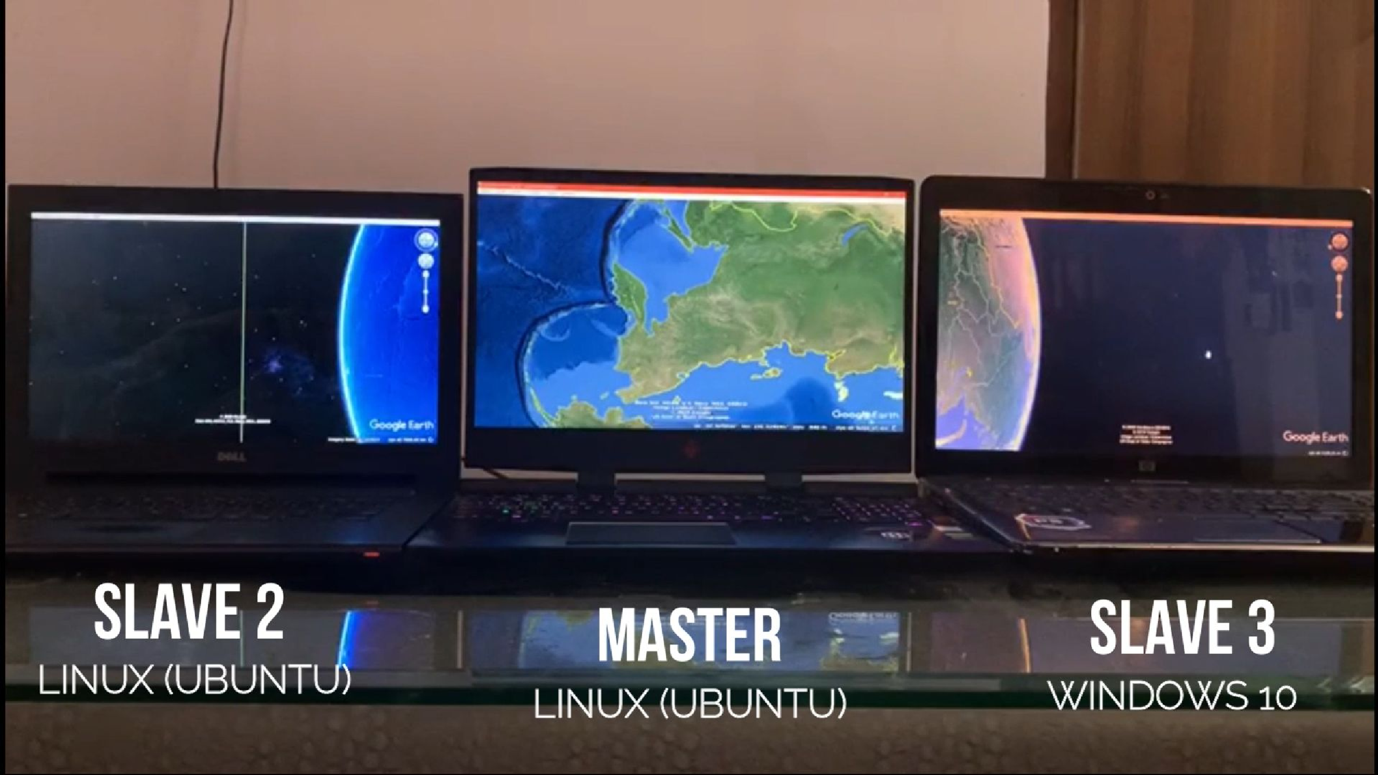
Prototype of Panoramic View

Slide 18
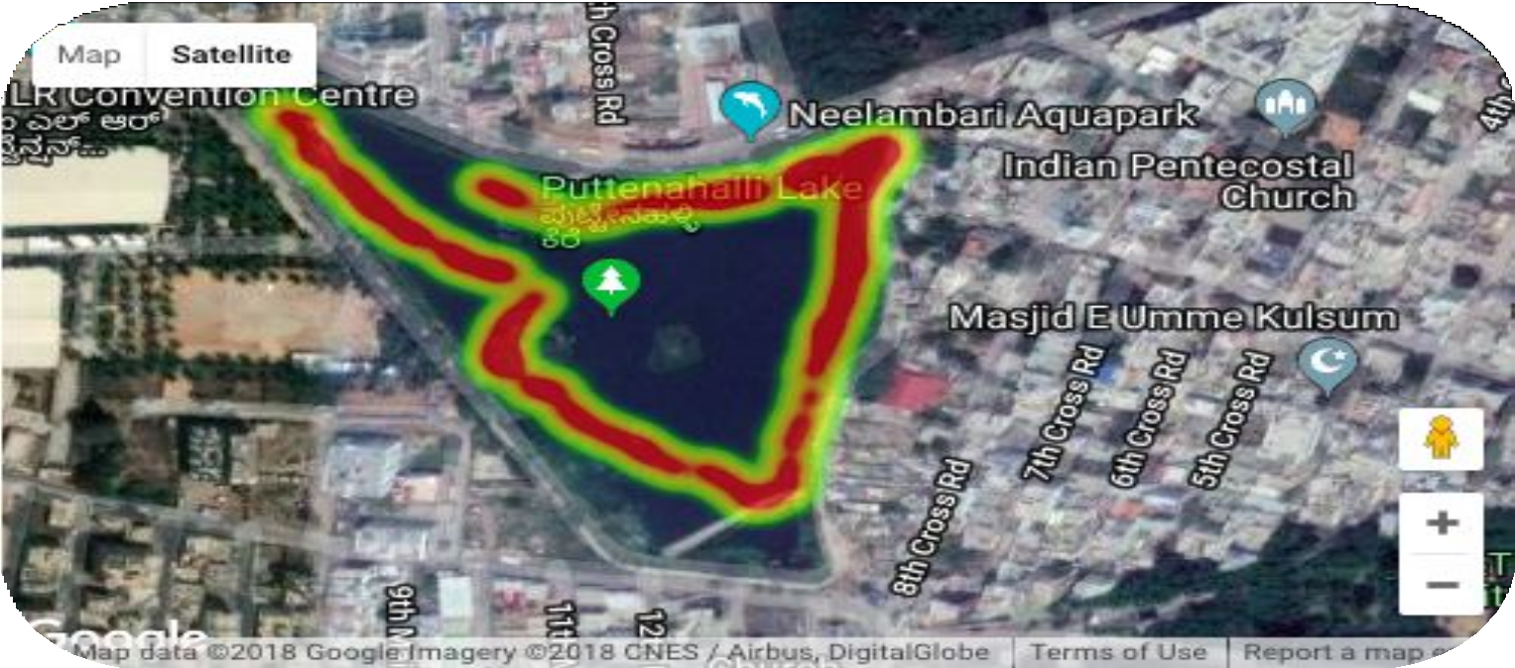

Such Heat Maps are generated by Sustainable Water Testing System systems on the basis of sensor data along with Google Maps API

Slide 19

Sustainable Water Testing System
One of the essential and novel feature will be tracking of the sources of pollutants in the water body.This will be done by the following STP (Source Tracking Process):
1.) Before the installation, the location of factories and industries connected to the river/lake will be marked in the system, using KML on Google Earth.
2.) If the Sustainable Water Testing System System, while testing, identifies that the parameters are beyond threshold in the same area which was marked, that would indicate that the respective industry is not following the treatment process, and an alarm will be initiated, along with it, a notification will be given to the authority along with the
18
proper information and maps.

Slide 20
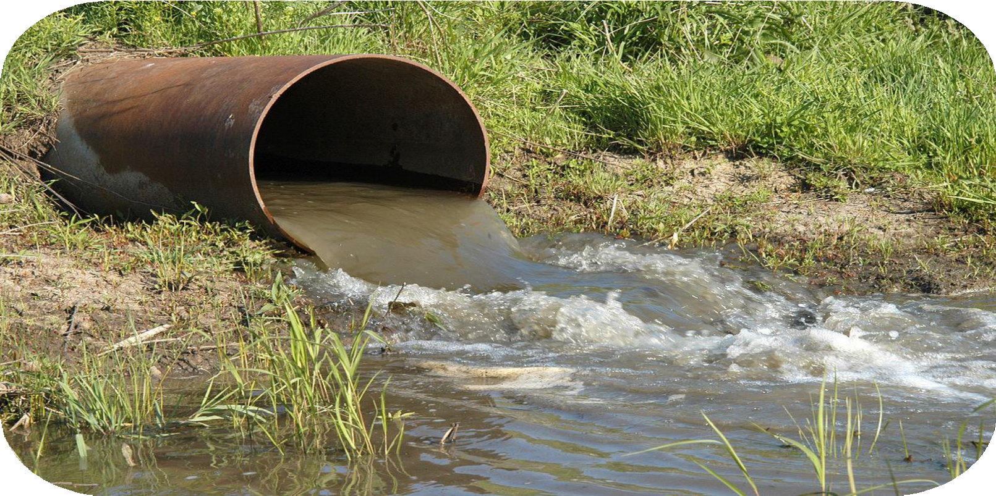
Source TrACKING Process
STP
(Source Tracking Process):
19

Slide 21
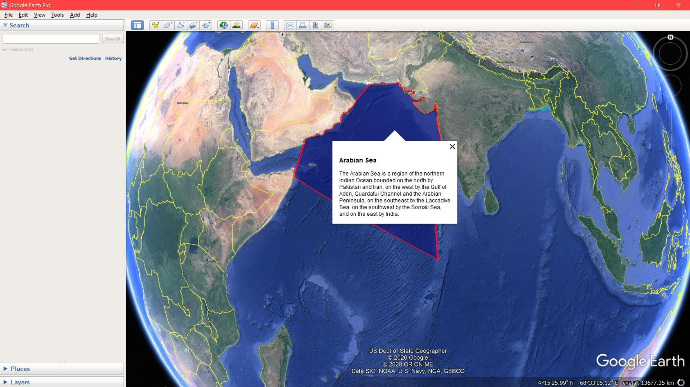
Sustainable Water Testing System
Usage Example of KML Language

Slide 22
SustAINABLE WATER SYSTEMS TESTING
Such a system would ensure that the entire water body is assessed and the status of every zone is covered in the report, It can be controlled wirelessly by Internet Platform or through the controller and the data will be streamed on the Web Platform. The person with the authority will have the credentials for accessing the website/app and analyse the data and the report. Abstraction of the data will be as simple.
So the entire system will be plug and play, the moment the system is kept inside the water body, It will start the sensor modules and streaming the data after successful calibrations.
21

Slide 23
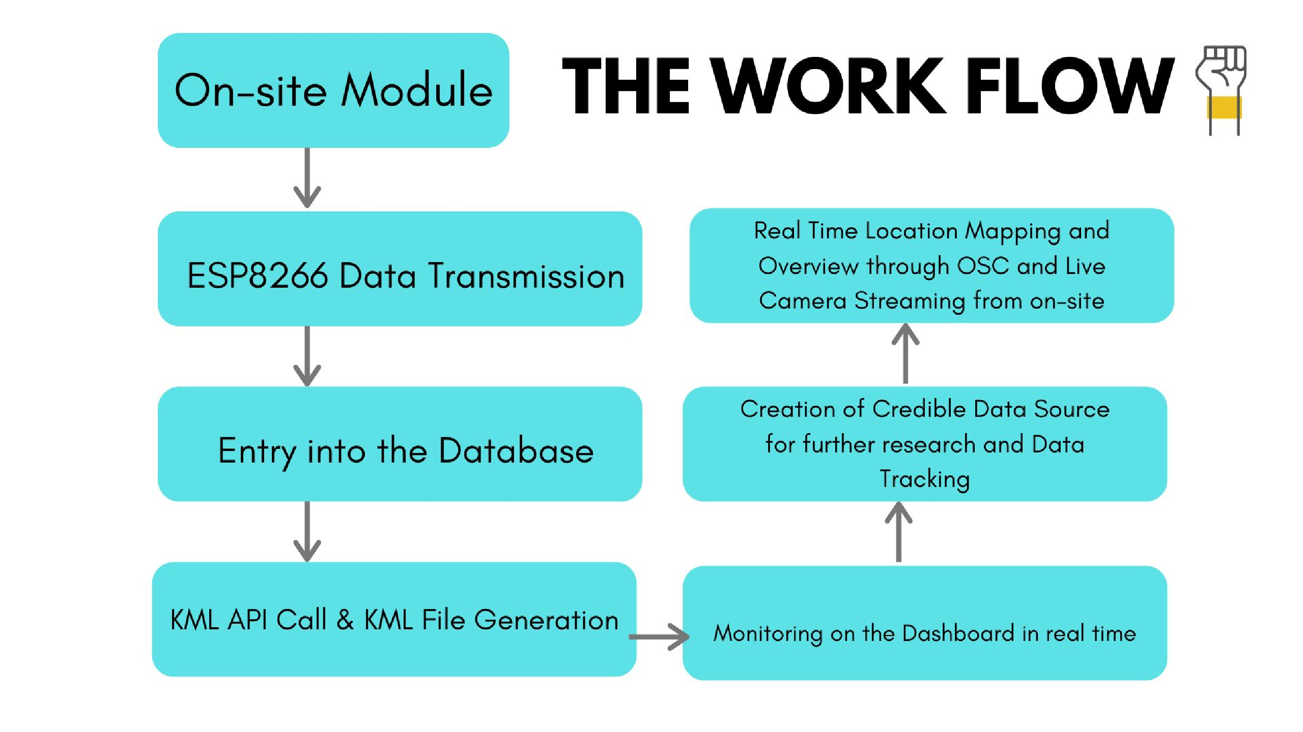

Slide 24

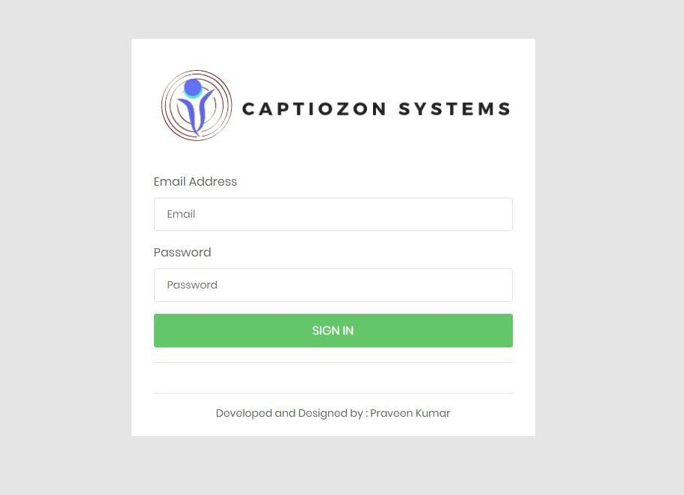
Sustainable Water Testing System
2.) SECURED LOGIN
User ID : Sustainable Water Testing Systemtesting@gmail.com
Password: usercheck

Slide 25
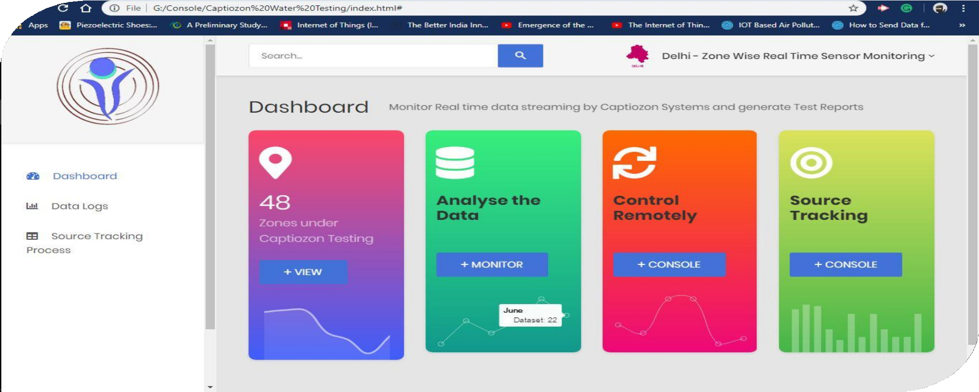

Slide 26

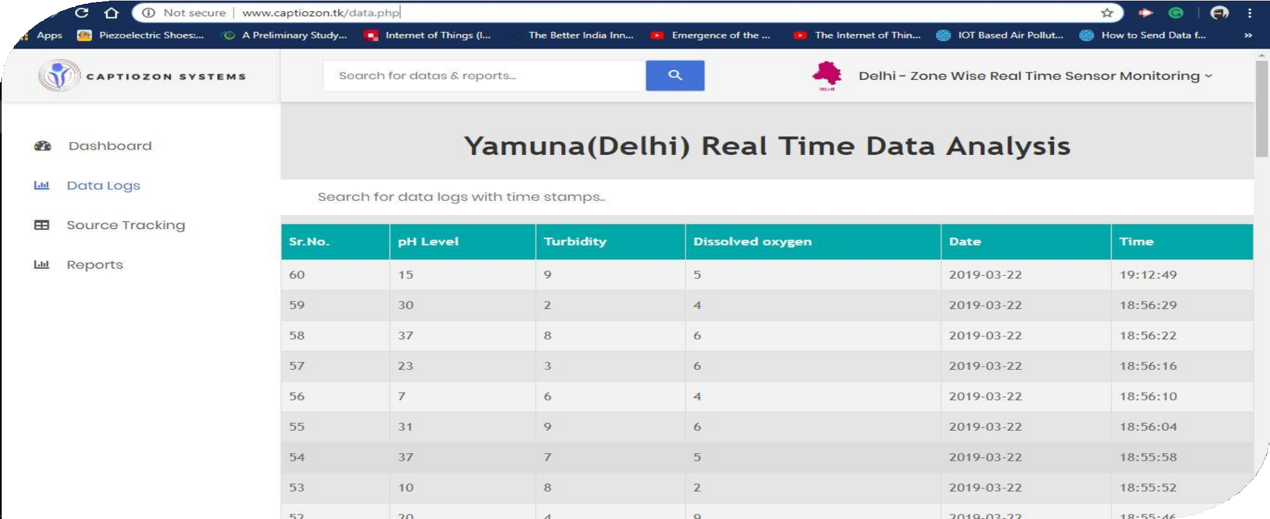
3) Sensor Data Stream

Slide 27
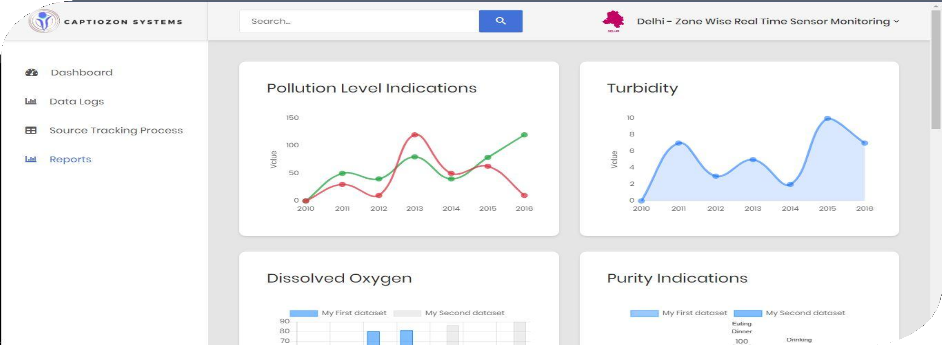
m
4) Reports Based on Data

Slide 28
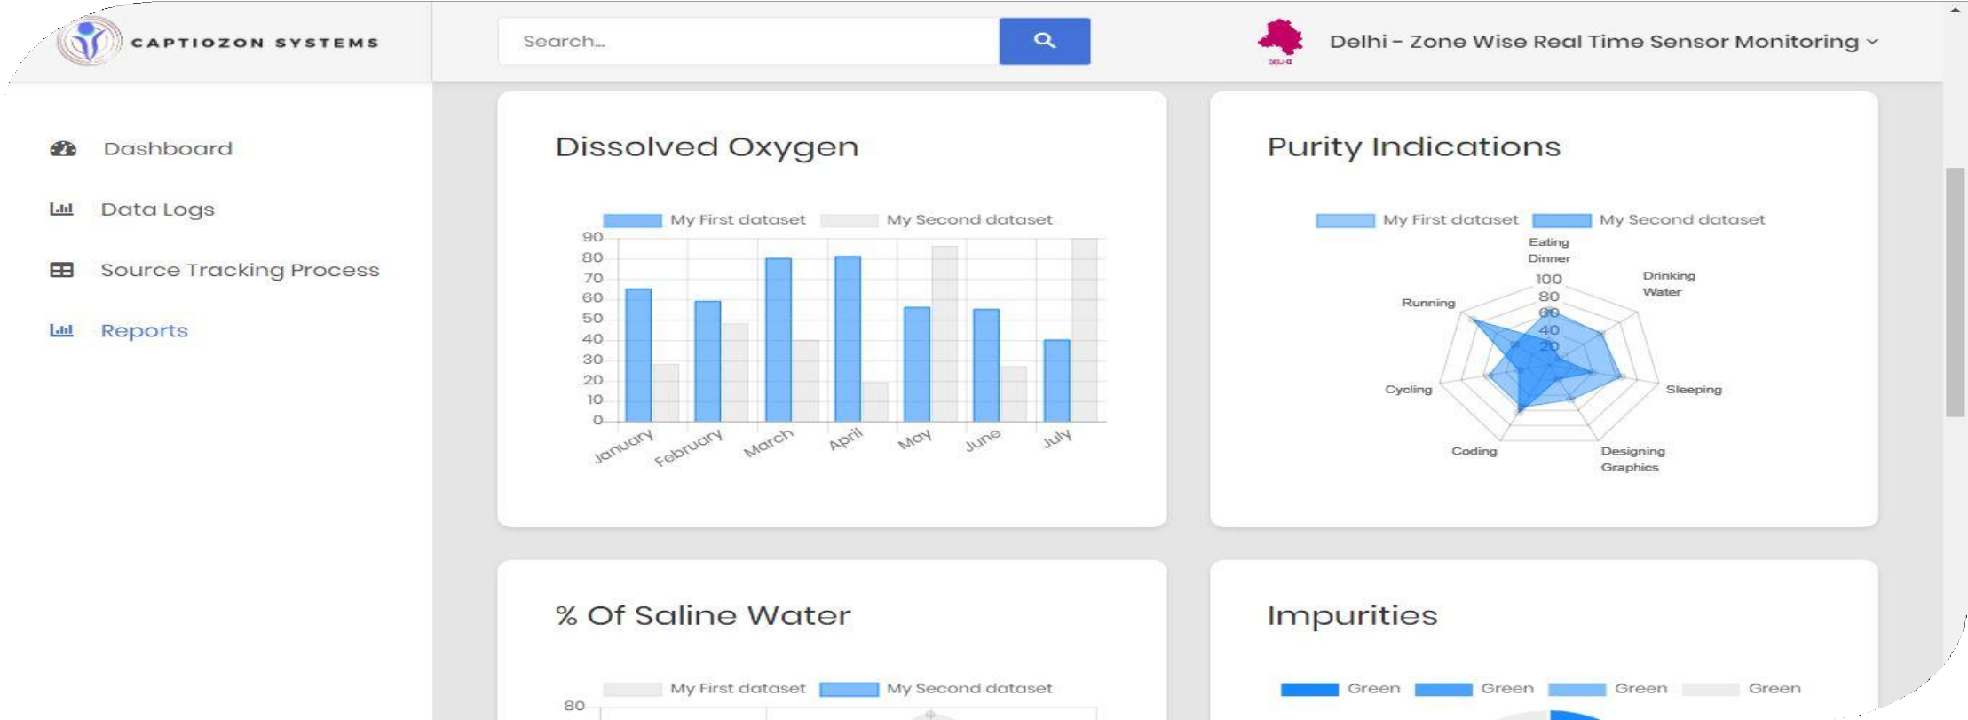
4) Various Responsive Data Charts

Slide 29
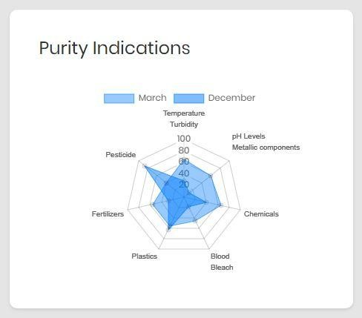
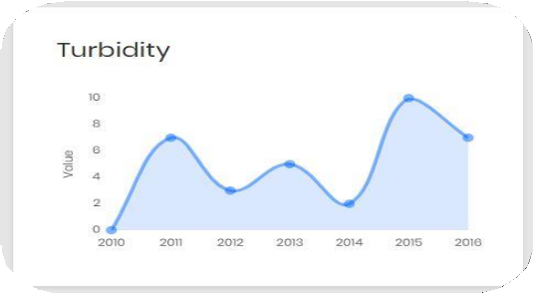
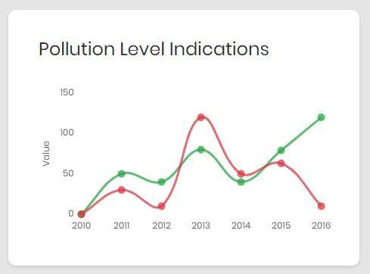
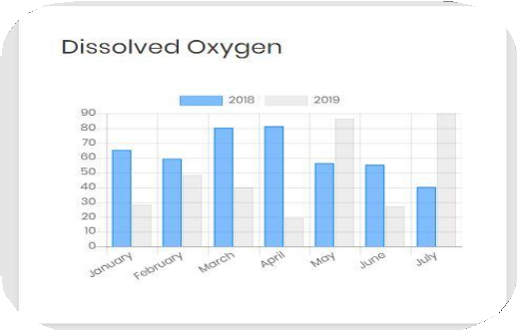
Sustainable Water Testing System
4) Data Charts

Slide 30
Sustainable Water Testing System
Note : These Charts and Indications are based on sample datasets published by the Microcontroller in accordance to the sensors(prototype purpose only), and once the system comes in action, the datasets will be formed by the sensor data taken from the water body by Sustainable Water Testing System Systems. These charts are self-designed by javascript & cascading style sheets.
What Sustainable Water Testing System means ?
Captiosus (Captio) means smart in Latin and Horizon (zon), together making Smart Horizons, which is beautifully representing the idea of smart solutions. It’s not a recognized word, I have tried to combine these two terms and form a name for my project. The name itself shall depict the³n⁰ ovelty of the project, even domain names are available with this name.

Slide 31
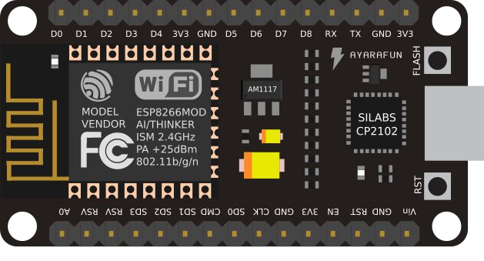

Sustainable Water Testing System
3) Sensor Data Stream

Slide 32
Sustainable Water Testing System
The concept is developed as per the problem statement provided by the Accenture HackerEarth, thus a working Hardware prototype has been developed which is able to publish/stream data from sensors to the Web Server by PHP POST Method, and then it is stored in MariaDB Database and then the data is monitored by the Sustainable Water Testing System Systems Dashboard. Moreover, the entire System consisting of all the sensors require for a proper water test, near to the product stage can be developed once this Idea is approved by the respective authority.
32

Slide 33
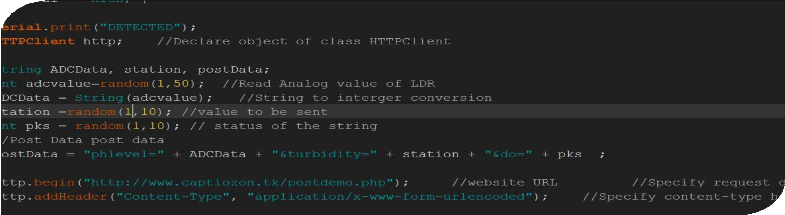
Sustainable Water Testing System
BACK-END
MCU Programming(Arduino C++)
33

Slide 34
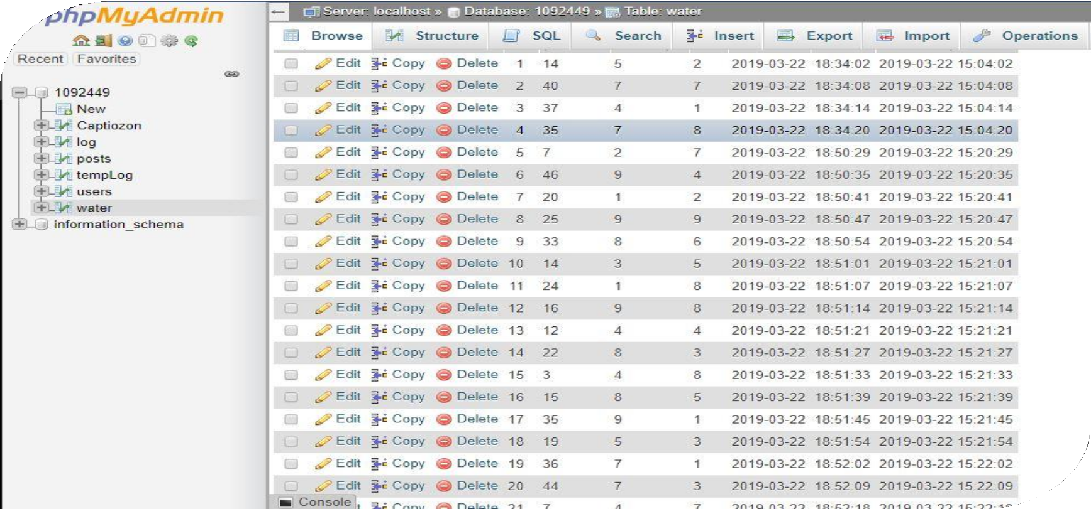
Sustainable Water Testing System
BACK-END
DATABASE STORAGE (MariaDB)
34

Slide 35
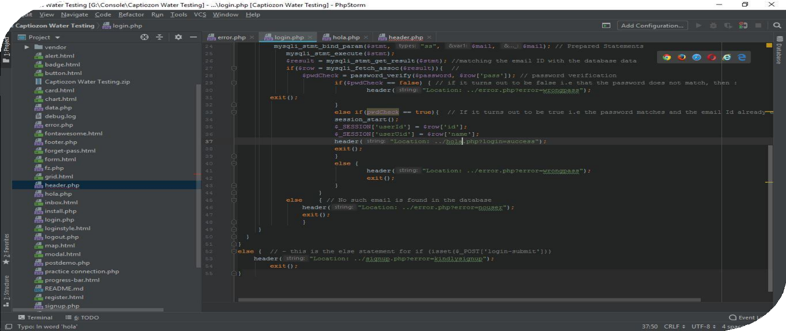

Sustainable Water Testing System
BACK-END
35
Hypertext Preprocessor PHP Programming for Logging and manipulating Data
+ Login System on PHP Storm Tool

Slide 36
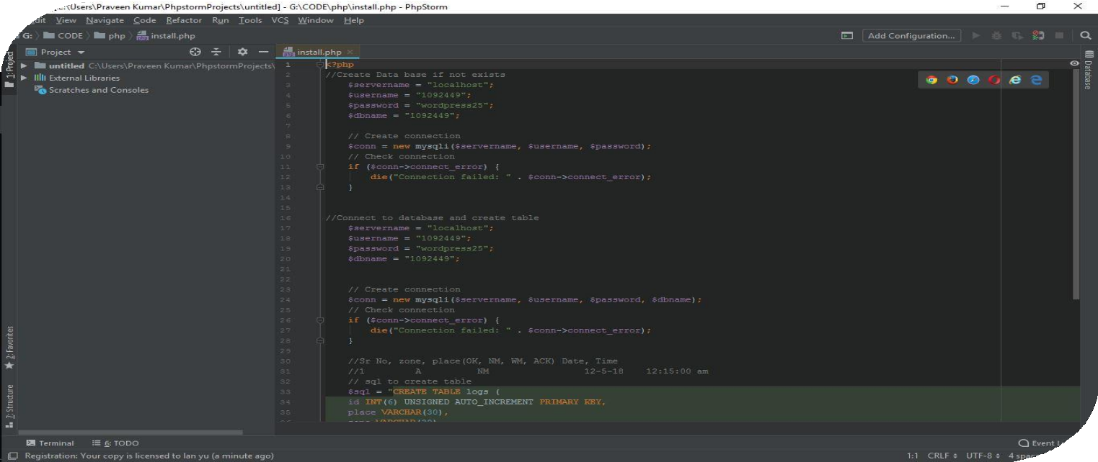
Sustainable Water Testing System
FRONT-END
³⁶HTML / CSS / Js / PHP & Bootstrap has been used for the UI Design of the Website

Slide 37
Sustainable Water Testing System
Hosting Details
Web Server : Apache/2.4.38 Database client version: libmysql - mysqlnd 5.0.12-dev - 20150407 - $Id Domain : Free .tk domain (Freenom.com)
37

Slide 38
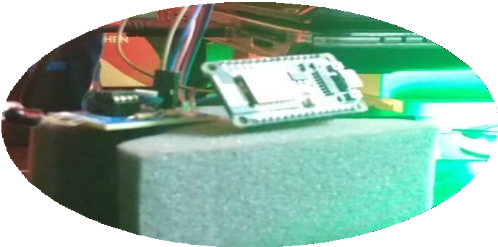
Sustainable Water Testing System
Hardware
Node MCU or ESP8266 WiFi chip is used to send the data to the web
38

Slide 39
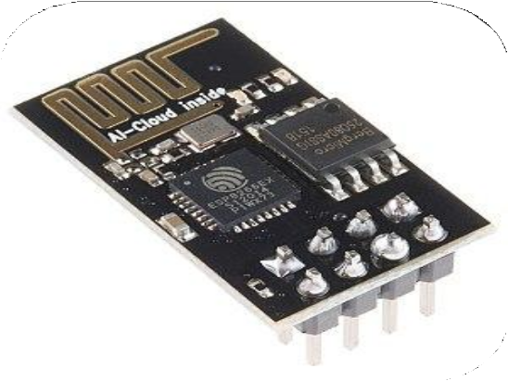
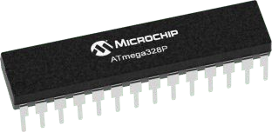
Sustainable Water Testing System
Hardware
ESP8266 WiFi module & Atmega328 Microcontroller in Arduino Genuino Uno for prototyping purposes has been used in the project along with nodeMCU
39

Slide 40
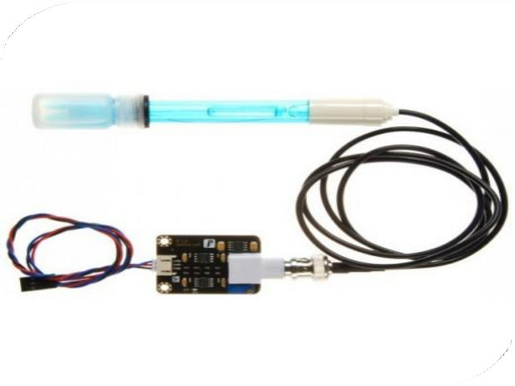
esting System
Hardware
pH Level sensor which is connected to the microcontroller through I/O pins
40

Slide 41
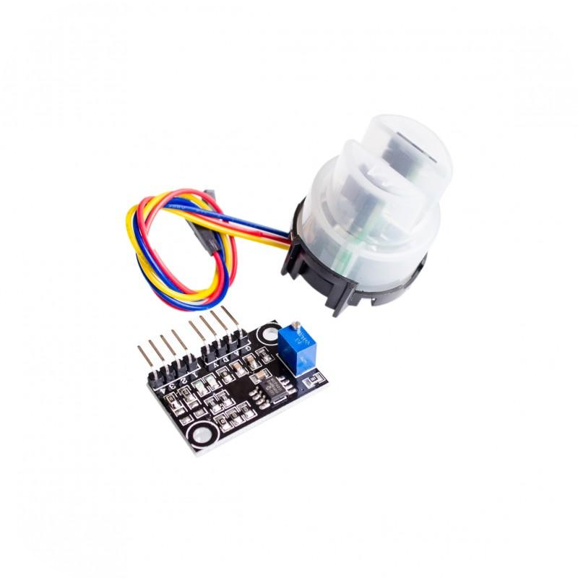
Sustainable Water Testing System
Hardware
Turbidity sensor which is connected to the microcontroller through I/O pins

Slide 42
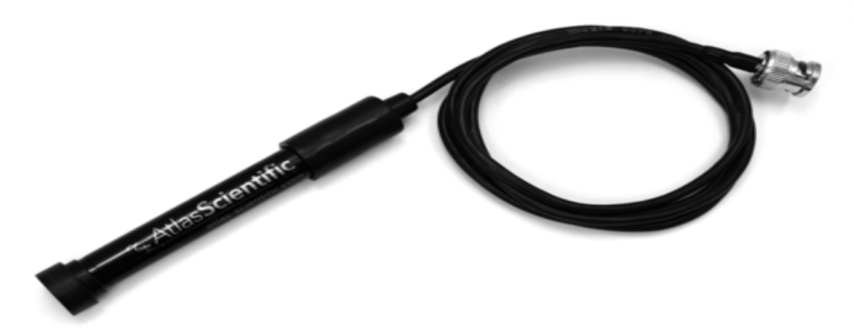
Hardware
Dissolved Oxygen sensor which is connected to the microcontroller through I/O pins
42

Slide 43
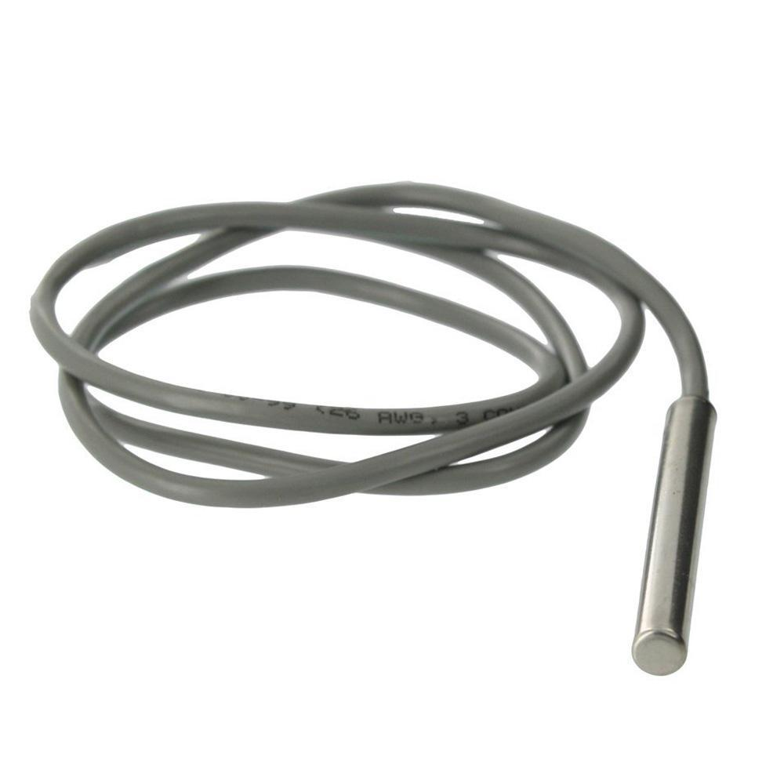
Hardware
Water temperature sensor which is connected to the microcontroller through I/O pins
43

Slide 44
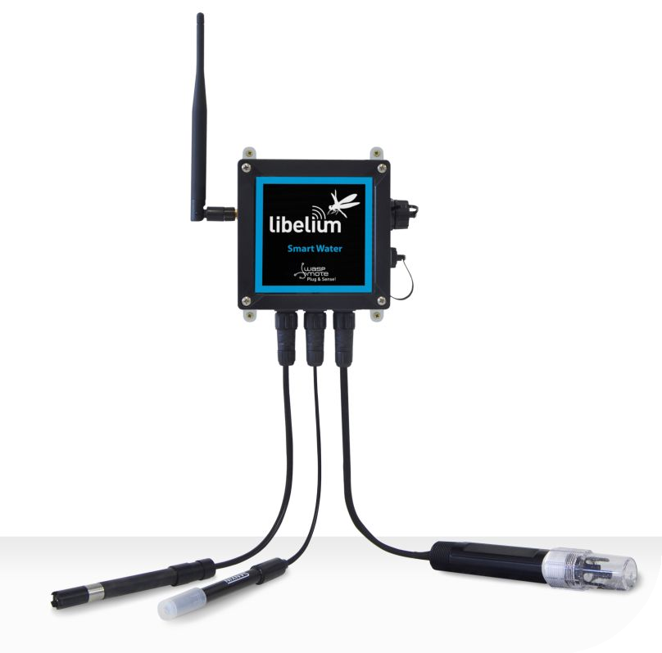
Sustainable Water Testing System
Hardware
Water Purity sensor which is connected to the microcontroller through I/O pins
44

Slide 45


THE SOLUTION IS :
Powered by IoT
LOW COST
Smart Framework
As IoT is booming these days, we need to utilise it’s scope and utility in every aspect possible.
The Entire electric consumption will be much less than the traditional methods of testing in labs
Real time data analysis and alert to the the source means
SOLUTION
45

Slide 46
In simple words, we can think of this as a controlled or autonomous moving system which will cover the entire zone of a water body and feed in several sensor data (eg. pH level, Temperature, DO, Turbidity etc.) and then send that data onto the database, there it is stored. Then a representative from the authority can simply log on to the system (Web/App Platform) and access all the data being streamed and thus analyse various factors related to it. So this removes the hassle of going on site, collecting samples and then testing it. Moreover, this can even detect and give proper proof report of the sources of major and minor pollutants. It can automatically detect various comparison reports and charts based on the datasets, which can
even help the government in taking decisions
46

Slide 47



Focus on one lake or river in Delhi or Pune
Collection of feedback and improvement of product from authorities
PILOT
(6 MONTHS)
Deployment in 5 zones in Pune or Delhi
Begin with Delhi
Partnership with Government Institutions
Phase – 1
Using it at every Lake/River/Sea/Pond in India
Phase - 2
STRATEGY
47

Slide 48
Such a System would ensure regular and accurate testing of purity and pollution level of water. The data thus procured by the smart low cost system, can indicate several threats and factors, which can then be taken care of by the authority. The scope of negligence will be negligible. The System that would act as a bot powered by the efficiency of Internet of things, will give real time reports from the sensor data and even locate the major sources of pollutants of water, so that the authorities can take action against them. Eventually this would enable efficient conservation of water from being exploited and increase the availability of clean drinking water for the public and make
this world a healthy place.
48

Slide 49
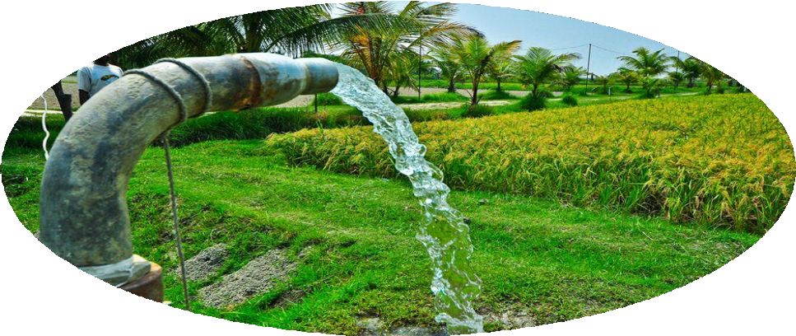
Moreover, the system can help the farmers optimize farm water to increase the efficiency of their agriculture processes. This can not only specify whether the water is appropriate for the usage in the farm. Moreover, the farmers can know how much of water they require.
49

Slide 50


DESIGNED & DEVELOPED BY :PRAVEEN KUMAR
THANK YOU
50

